Slide 1
Air Ticket Booking
UV Trips
Trainer: Javeed Sir
Team-10
------------
T. Uday Kiran-JA22
V. Yashwanth-JA23

Slide 2
Backend Technologies
Java
Spring Boot
Spring Data JPA
Rest API
Spring Security-JWT
Unit Testing
Swagger

Slide 3
FrontEnd Technologies
HTML 5
CSS 3
Typescript
Bootstrap 5
Angular

Slide 4
Air Ticket Booking
Has Three Actors-
Admin
Flight Owner
User

Slide 5
Admin Functionalities
Add Flight Owners
Manage Users
Manage Flight Owners
Manage Bookings
Edit Profile
Change Password

Slide 6
Flight Owner Functionalities
Add Flights
Manage Flights
Manage bookings under his/her Flights
Edit Profile
Edit Flights
Change Password

Slide 7
User Functionalities
Registration
Login
Booking Tickets
Edit Profile
Manage Bookings
Change Password

Slide 8
Ticket Booking Process
User Registration
User Login
Search Flights
Select Seats
Passenger Details Entry
Book a Ticket
Ticket Display
Download Ticket

Slide 9
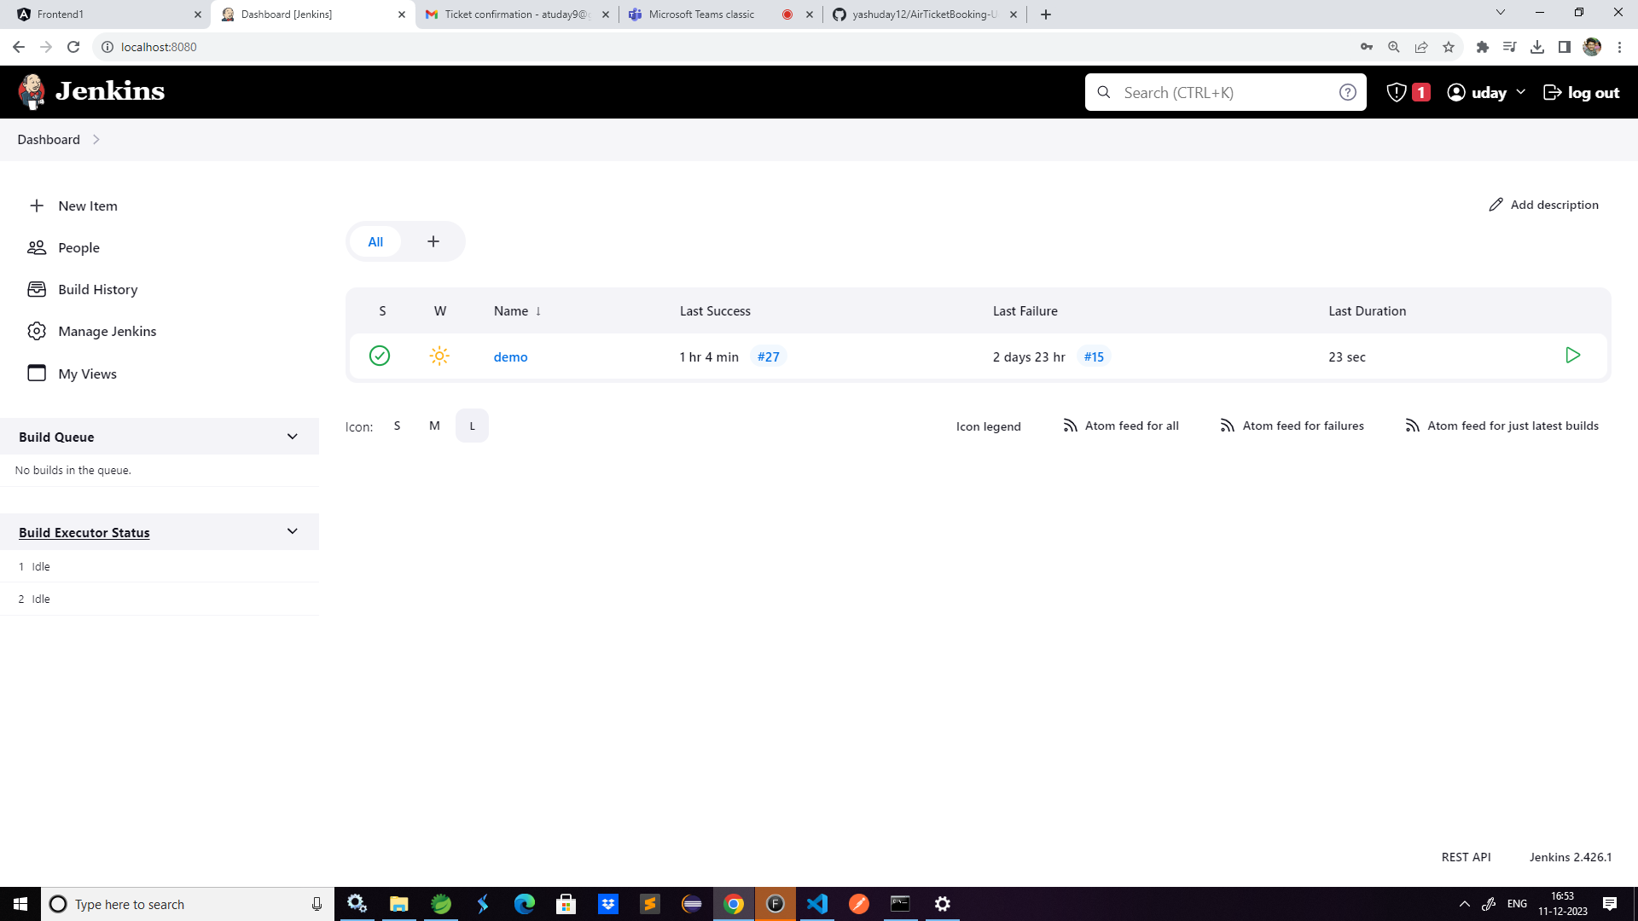
Jenkins
We pushed our backend project to github repository and if there are any changes are made to the project, in Jenkins an automatic build is triggered for every minute, so that we can achieve continuous Integration(CI).
Created a job In Jenkins with name demo

Slide 10
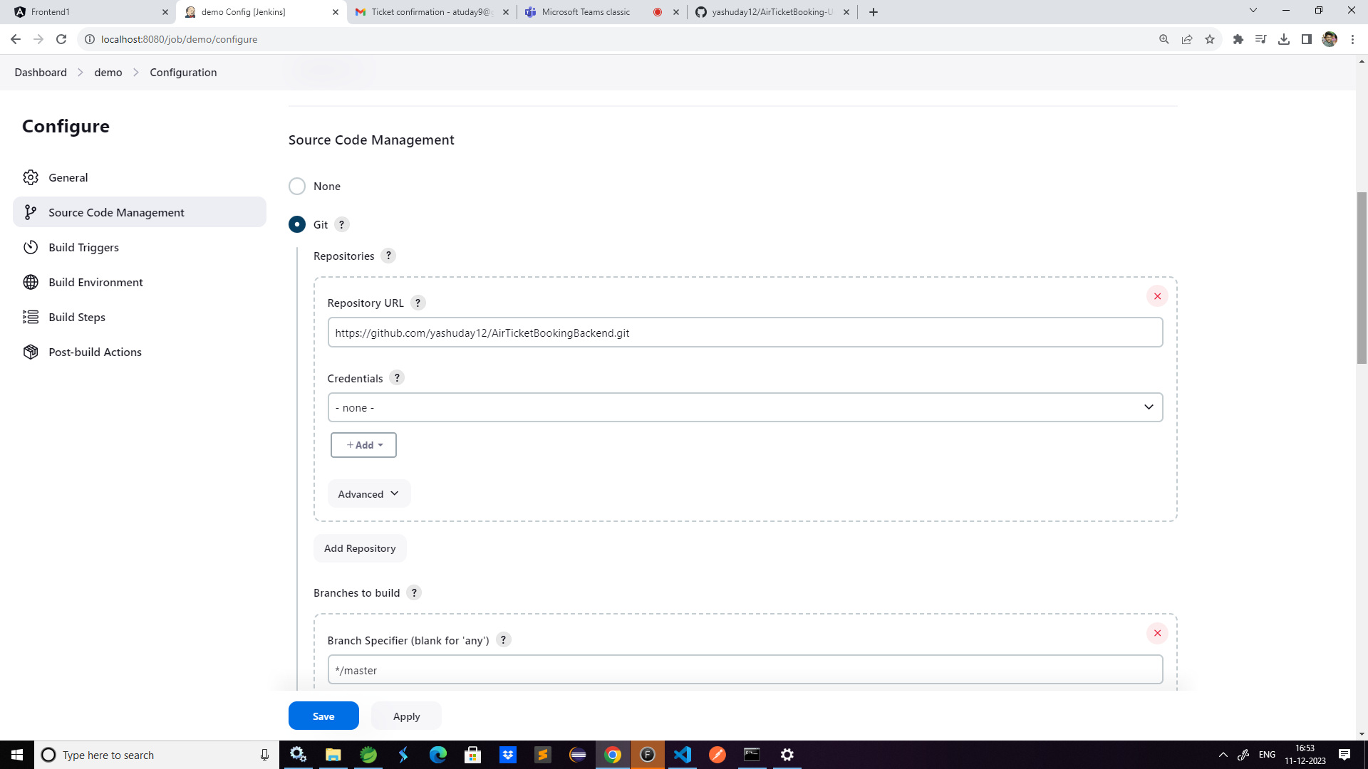
Also information regarding our github repository url and is configured and also a build is scheduled for every minute using Poll SCM

Slide 11
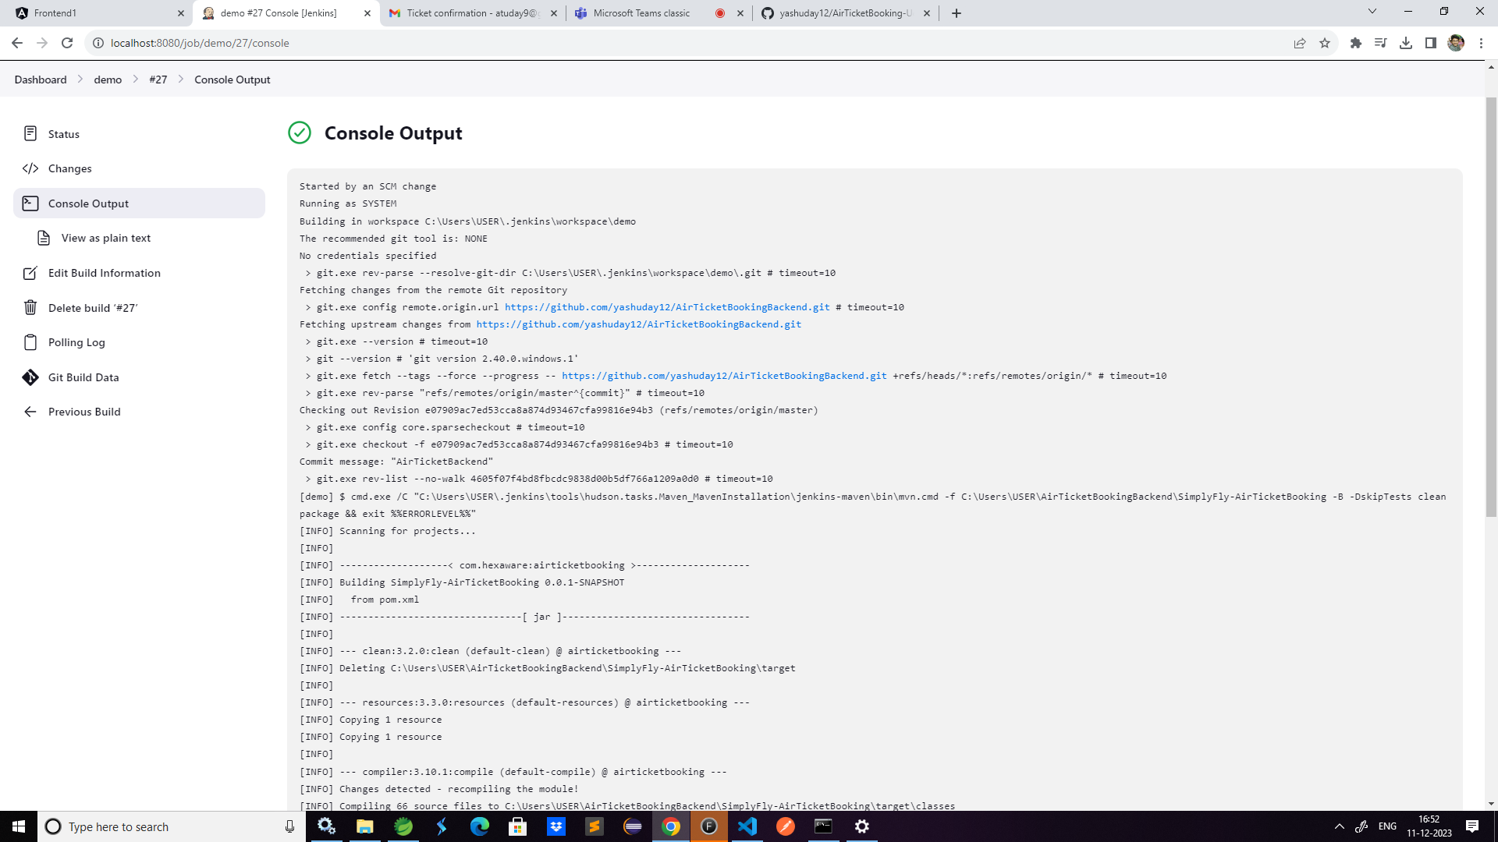
Build is triggered when changes are made to code in github and build is successful, we can see it in console output

Slide 12
Project Source
Reference Links
GitHub Link-
https://github.com/yashuday12/AirTicketBooking-UdayKiran-and-Yashwanth-Team-10-

Slide 13
Thank You

